Slide 1

Save Energy Improve Uptime
Green DC: It’s all about Energy!

Slide 2






Company Overview
Datacenter energy & uptime management solutions
Founded in Feb’09 in Lochristi, BE & HQ in U.S.
Funded by Partech International & Big Bang Ventures
Early traction in Europe & U.S.
Datacenter & Energy veterans / serial entrepreneurs

Slide 3
Executive Team & Board
Marco DeMiroz President & CEO
Soliant Energy: CEO & COO. Cleantech & IT VC: Trinity Ventures, Selby Ventures; SVP Fujitsu; General Magic, Sun Micro and Oracle.
Wilbert Ingels CTO & Founder
Dedigate: Founder; Terremark: SVP Sales Managed Hosting / COO Europe; Level 3: Sales Director; A-Server: CEO.
Ed Sterbenc Vice President, Worldwide Sales
Modius: VP Sales; Nimsoft: VP Sales; SharkRack: CEO; Tandem: VP WW Sales Ops; IBM
Kristof DeSpiegeler Chairman & Founder
Qlayer: Founder (acq. by Sun); DataCenterTechnologies: Founder (acq. by Symantec); Dedigate: Founder (acq. by Terremark); Hostbasket: Founder (acq. by Telenet)
Nicolas El Baze Partner – Partech International
Frank Maene Managing Partner – Big Bang Ventures
Racktivity Confidential
3

Slide 4
Racktivity Mission
Save ENERGY & Improve UPTIME
in
Data Centers
Racktivity Confidential

Slide 5





Green Data Center
WHAT MAKES IT GREEN?
Renewable Energy
Energy Efficiency & Sustainability
IT & Facilities
Virtualization & consolidation
Dynamic energy & uptime management
Design & Engineering
Processes, governance, policy…
Racktivity Confidential

Slide 6
Data Center – Global Growth
MAIN DRIVERS of GROWTH:
Consumer data: Explosive growth of online digital content worldwide; videos, photos, social networks
Enterprise Computing: Main shift towards virtualization and cloud computing
Mobile data: Rapid adoption of smart phones&devices; iPhone, iPad, Android, driving mobile data traffic
All require sustained growth of data centers around the world

Slide 7
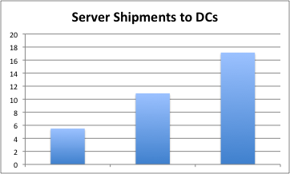
Data Center – Global Growth
In MMs
2000
2006
2010
Source: IDC
Racktivity Confidential
7

Slide 8
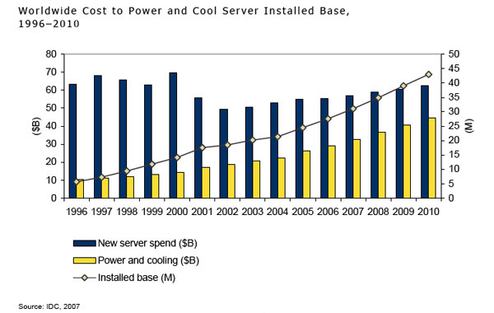
DC Energy Cost: Shift fm CapEx to OpEx
Racktivity Confidential
8

Slide 9
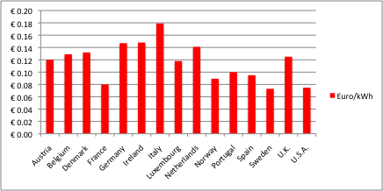
Average Electricity Price for Commercial Customers
Global DC energy consumption is approx 240 TWhs in 2010
Racktivity Confidential
9

Slide 10
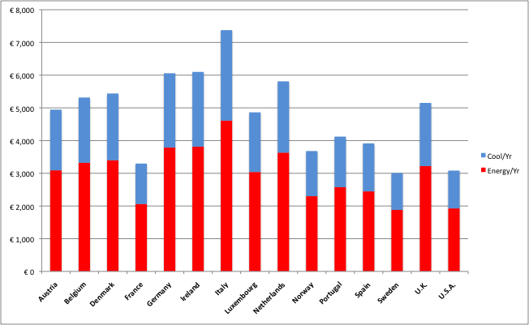
Annual Energy Cost to Power & Cool – 3 kW Blade Server (@ PUE 1.6)
Racktivity Confidential
10

Slide 11
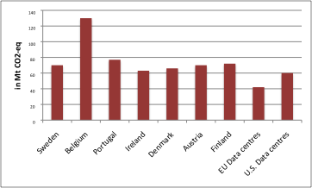
Annual CO₂ Emissions
€20B/yr electricity fees
Racktivity Confidential
11

Slide 12
Racktivity Solutions
ENERGY & UPTIME
Management Solutions
for
Data Centers
Racktivity Confidential

Slide 13

Focus on the Physical Layer of Cloud
Most IT effort in the cloud is focused around upper layers
Little attention at physical infrastructure layer for power optimization, automation, disaster prevention, remote control, monitoring, recovery
Issues in lowest layer result in large costs and downtime
Short circuits
Overloaded power strips
Overheating servers/disks
Power spikes
Defective
power supplies
Humidity
Hardware: Servers, Switches, Storage Systems, …
Datacenter Infrastructure:
Racks, Power, HVAC, Building+ Security
Racktivity Confidential
13
Notes:
13

Slide 14
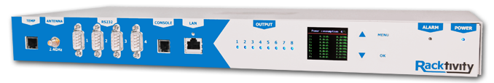
Solution = Data Center Energy & Uptime Management (Integrated SW & HW)
Hardware Platform: Next-gen Smart PDU Rack Controller
Software Platform: Comprehensive Middleware and App Layer
Power/Energy Management
Module
Uptime
Management
Module
Other DC Apps
VM, OpenView
Other DC Apps
VM, OpenView
The Rack Controller measures current & volt 320000/sec per device as well as temp, humidity & airflow.
Racktivity Data Center Platform
Racktivity
Rack Controllers
Racktivity
Rack Controllers
Other PDUs
APC,….
Other PDUs
APC,….

Slide 15
Data Center Energy & Uptime Management (Integrated SW & HW)
SW Platform: Energy & Uptime Management
Complete & detailed visibility to DC energy consumption
Remote management of IT systems energy use
Diagnostics & detection to improve uptime & availability
Integration with virtualization & administrative app layer
Report CO₂ emissions and reductions
Rack Controller: Intelligence & action
Temperature protection: power off overheated servers
Integrated power-on protection
Integrated power overload protection (software fuse)
Power capacity planning on rack basis (don’t overload rack)
Open and extensible to integrate & enhance DC investments

Slide 16
Rack Controllers: Next-gen Smart PDUs
Unified Design to meet varying Data Center needs
1U Products
0U Products
8-ports, single phase
100-240V 16-20A
Shipping in Europe
U.S. in 1Q11
24-ports, single/triple phase
100-277V 16-32A standard
Up to 415V and 60A options
Shipping in U.S. & EU in 1Q11
All bundled with Web portal for remote monitor & management
All products have both switch & metering capabilities at outlet level
Multiple programmable actions for management and alerts
Detailed log files for diagnostics
Precise measurement of Power Factor and True RMS Voltage, Current, Power per port

Slide 17
Open SW Platform to Enhance DC Investments
HP OpenView
IBM Tivoli
CSCO EnergyWise
Siemens
Johnson Liebert
VMWare Microsoft
Citrix/Xen
IT Systems & Admin
Building Controls
Virtualization
Uptime & Energy Management
Energy Consumption Analysis
Environment Monitoring
Power & Server Provisioning
Visualization
Graphical Navigation
Dashboards
Racktivity Platform
Energy Consumption
Cooling
Equipment
Environmental
Data
Servers &
Storage Data
Racktivity Confidential
17

Slide 18
Save Energy – Integrated Energy & Uptime Mgmt Platform
Up to 40% of energy consumption & cost
Provide visibility to physical layer behaviors: energy & temp
Remotely manage IT asset energy consumption
Move servers based on event triggers & energy profile
Integrate with hypervisors: VMW, Hyper-V, Xen, VirtualBox
Integrate with other DC apps: Tivoli, OpenView, EnergyWise,..
Interact with other PDUs: APC,…
Racktivity Confidential
18
Notes:
18

Slide 19
Save Energy Improve Uptime
Green DC: It’s all about Energy!

